Slide 1
Eastern User Group
Welcome!
Made possible by our Strategic Partners

Slide 2
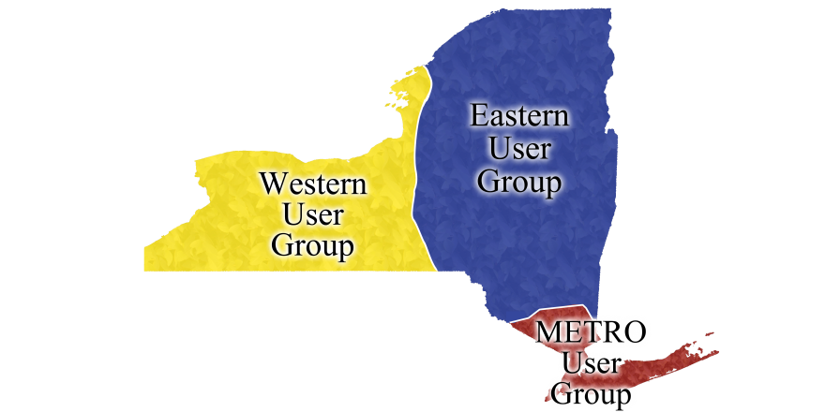
Eastern User Group Libraries
Binghamton University
Broome Community College
Cobleskill
Columbia-Greene
Delhi
Empire State College
Fulton-Montgomery
Herkimer
Hudson Valley
Mohawk Valley
New Paltz
New York State Library
Oneonta
Onondaga
Orange
Plattsburgh
Schenectady
Sullivan
SUNY IT
The College of St. Rose
Ulster
Utica College

Slide 3
IDS Project (idsproject.org)
Promoting library excellence through community & technology

Slide 4
IDS Annual Conference 2013 August 1st and 2nd Syracuse, NY We are looking for volunteers for the Conference Planning Committee and to help at the Conference.
Please contact Bill Jones @ 585-245-5172, jonesw@geneseo.edu

Slide 5
IDS Annual Conference 2013 Combined Regional User Groups Meeting July 31st , 2013 Syracuse, NY
Do you have a topic you would like to present at the Combined User Group Meeting?
Please contact Micquel Little @ 585-385-7340, mlittle@sjfc.edu

